Slide 1
Ethical and Responsible Data Management
EDS213 - Databases & Data Management
Week 8
Renata Curty
Research Data Services, UCSB Library
rds@library.ucsb.edu

Slide 2
Learning Objectives
Understand key ethical and responsible data management principles, focusing on the importance of data documentation, preventing bias and harm, properly handling sensitive data, ownership, and licensing issues.
Relate ethical and responsible data management principles to real-world scenarios.

Slide 3
Common DM Challenges
High-volumes of data
Record and reason about the veracity and credibility of the data
Manage the variety and heterogeneity of multiple underlying data sources, including achieving interoperability across datasets
Ensure all data are enhanced with appropriate metadata capturing, rich information about the data and important inter-relationships
Find appropriate mechanisms and techniques to support integration of different datasets to enhance scientific discovery
Blair, G. S., Henrys, P., Leeson, A., Watkins, J., Eastoe, E., Jarvis, S., & Young, P. J. (2019). Data science of the natural environment: a research roadmap. Frontiers in Environmental Science, 7, 121. doi: https://doi.org/10.3389/fenvs.2019.00121

Slide 4
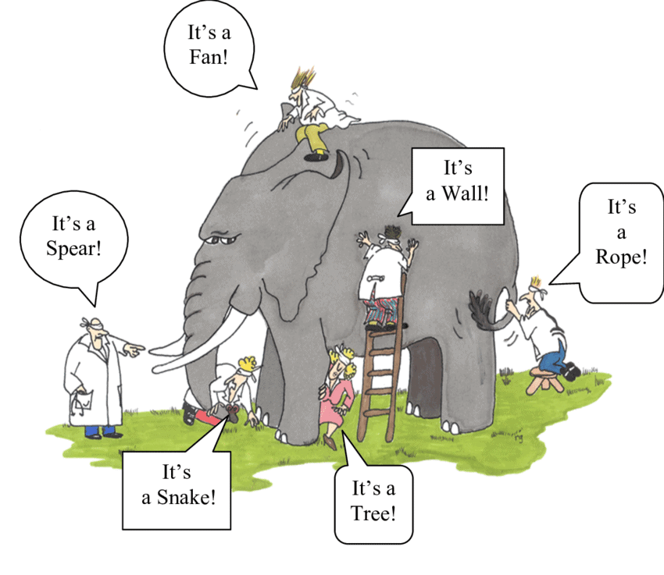
Data Management
Encompasses social, legal and technical aspects
Includes logistics and methods to oversee data
Seeks better efficiency, productivity and reusability
Requires an integrative view of the project and the data lifecycle
Image: Renee Guzlas

Slide 5
Ethical and Responsible Data Management
Existing norms, standards or understandings about how we should handle data.
Encompasses practices and processes used to collect, store, protect, share, and use data in a way that respects privacy, promotes transparency and accountability, and ensures data accuracy, and reliability.

Slide 6
Ethics - Key Guiding Principles
Fairness (diversity, inclusivity, no bias)
Accountability (moral and legal public “answerability” and compliance)
Transparency (understood from the outside)
Privacy/Protection (prevent unauthorized disclosure and adverse effects)
Integrity (trustworthiness, accuracy and consistency)

Slide 7
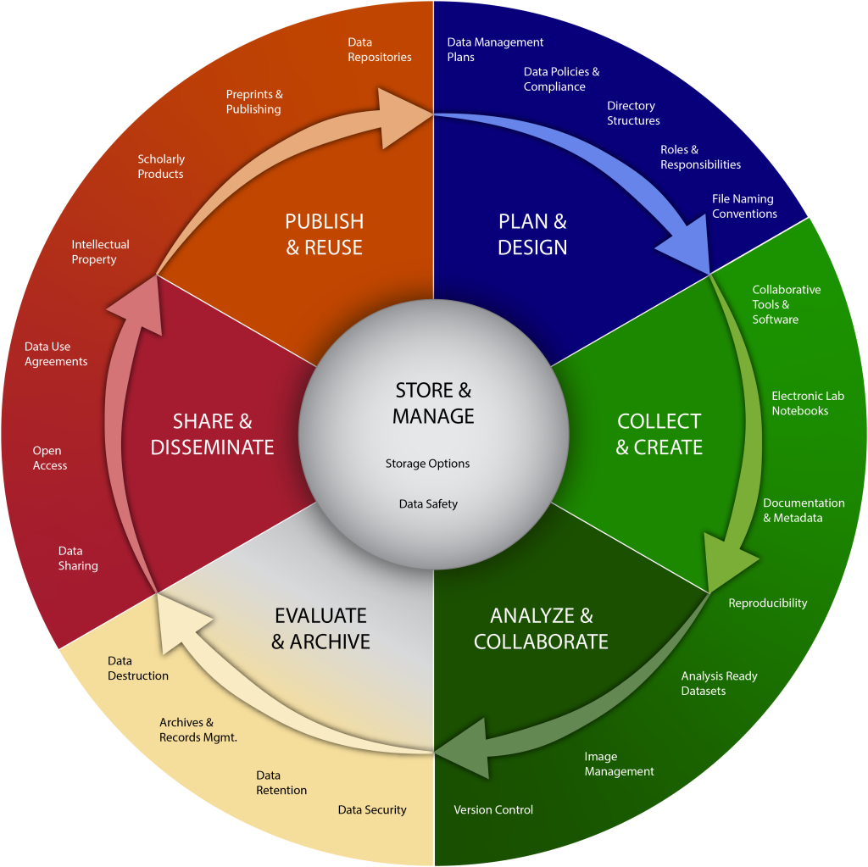
Data
Management
(Lifecycle)
Ethically & Responsibly
Adapted from: LMA Research Data Management Working Group (2023)

Slide 8
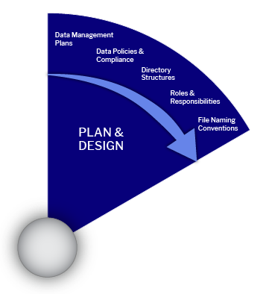
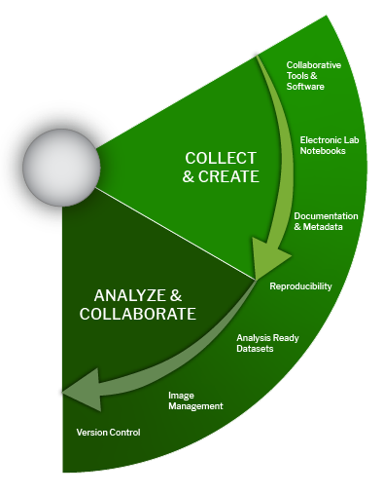
Potential DM Issues
PLAN & DESIGN
COLLECT & CREATE
ANALYZE & COLLABORATE
Causing or Perpetuating Harm or Injustice
Negative direct or indirect impact on individuals, groups or communities due to the lack of diversity and representation, existence of bias (unjustifiable concentration on a particular side), lack of cultural sensitivity, or unfairness (discriminating treatment of data and people) present in the data.
Ethically & Responsibly

Slide 9
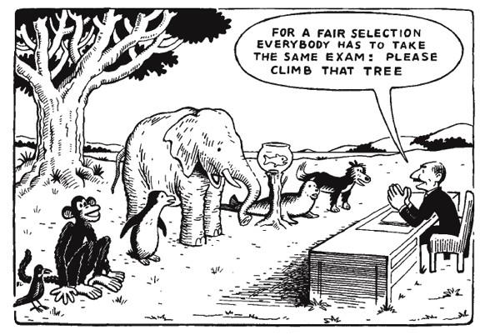
Fairness, Bias & Adverse Impact
Traxler (1976), “Climb that tree”

Slide 10
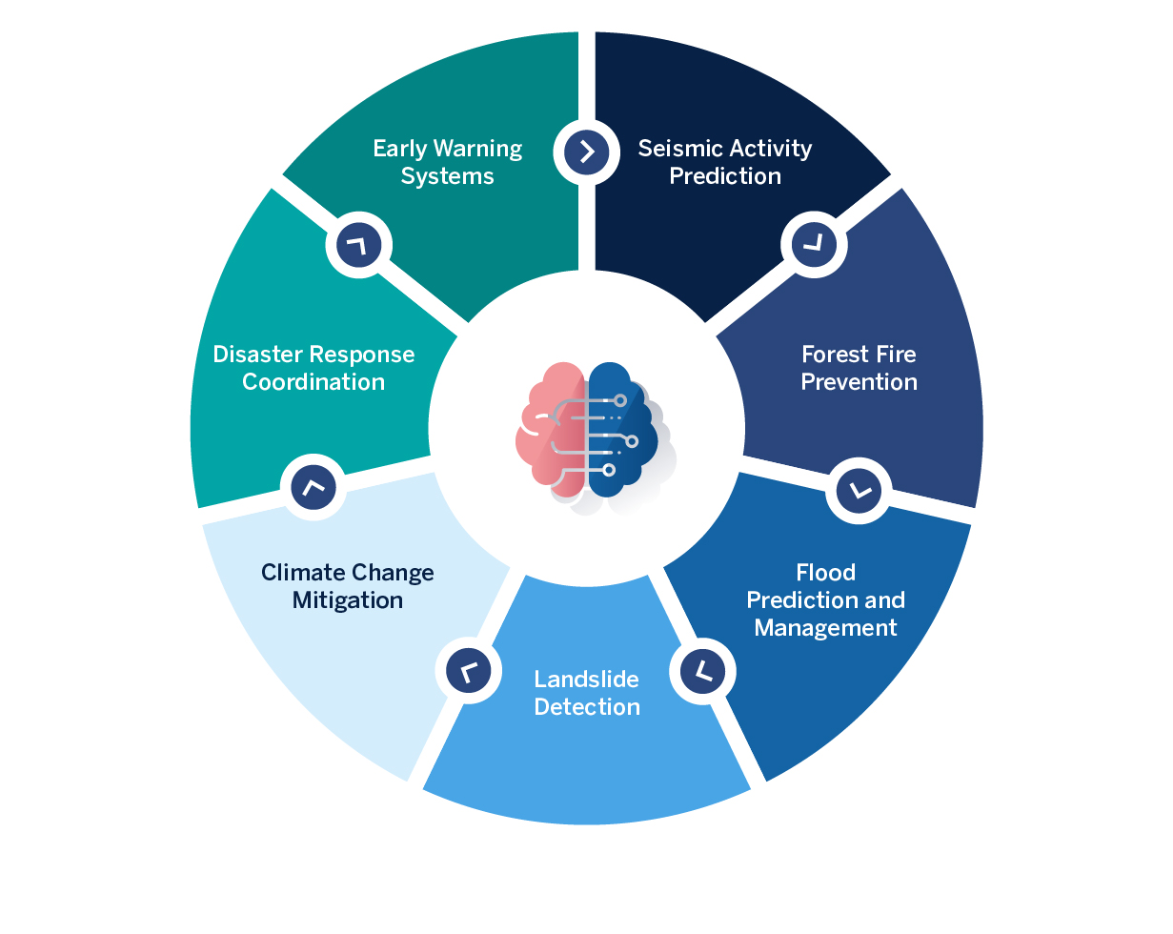
Example: Disaster Prevention
Predictive Models
Preparedness plan
Emergency response
Contextual information?
Any limitations/biases in data?
Community needs?

Slide 11
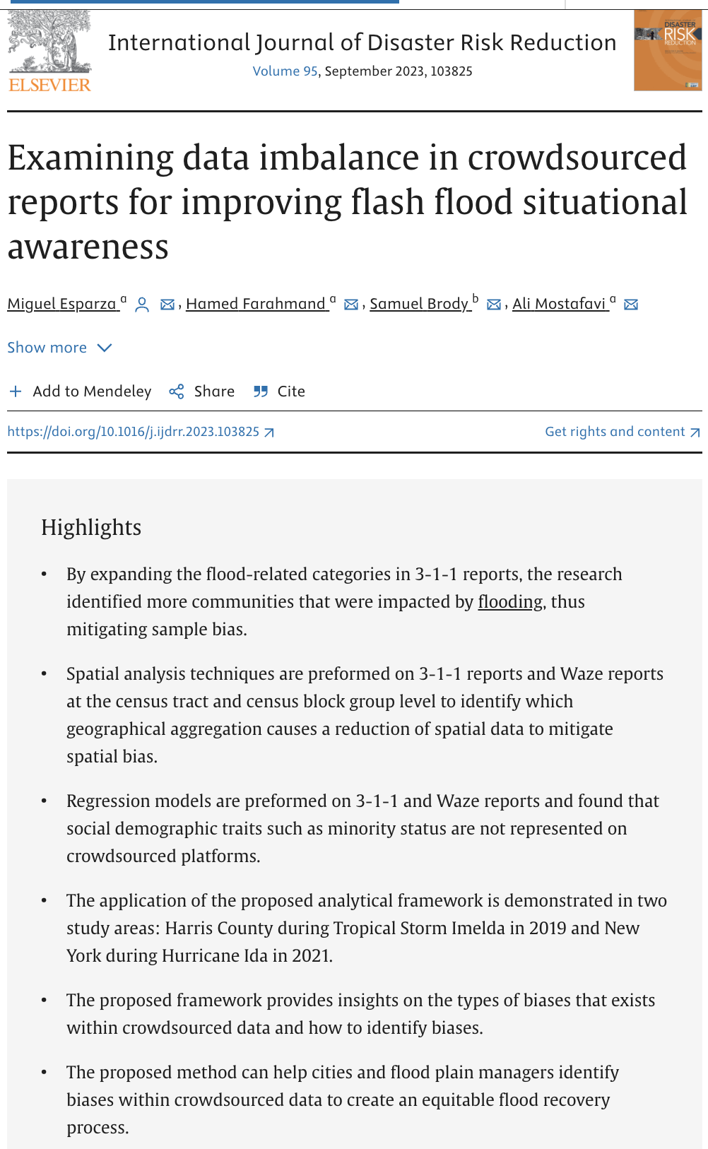
Bias Assessment
Sample Bias: Can affect the overall validity of the study results, making them non-generalizable.
Demographic Bias: Can lead to findings that do not accurately reflect the experiences or conditions of underrepresented demographic groups.
Spatial Bias: Can result in inaccurate geographical conclusions or interventions that may not be effective across different areas.
https://doi.org/10.1016/j.ijdrr.2023.103825

Slide 12
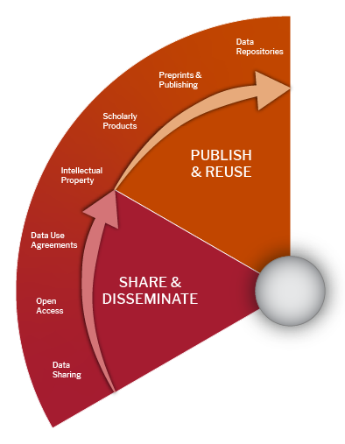
Potential DM Ethical Issues
COLLECT & CREATE
ANALYZE & COLLABORATE
SHARE AND DISSEMINATE
PUBLISH & REUSE
Inability to reproduce/interpret or lack of transparency
Poor documentation practices and absence of metadata can make it difficult to determine the accuracy, credibility and validity of the data, and may raise questions about whether the data has been manipulated or fabricated. It also prevents reproducibility and scientific advancement or lead to misuse and misinterpretation.
Ethically & Responsibly

Slide 13
How reusable?
mg/L or ppm?
Sampling Point | Date | Polluant A | Polluant B | Polluant C
A | Jan. 10 2022 7:00 AM | 999 | 7 | 0.3
B | 10/1/2022 7:00 AM | 6 | 3 | 9
C | 10/1/2022 7:00 AM | 4 | 4 | 5
D | Oct. 1 2022 7:00 AM | 3 | 500 | 4
E | 10/1/2022 7:00 AM | 2 | 6 | 7

Slide 14
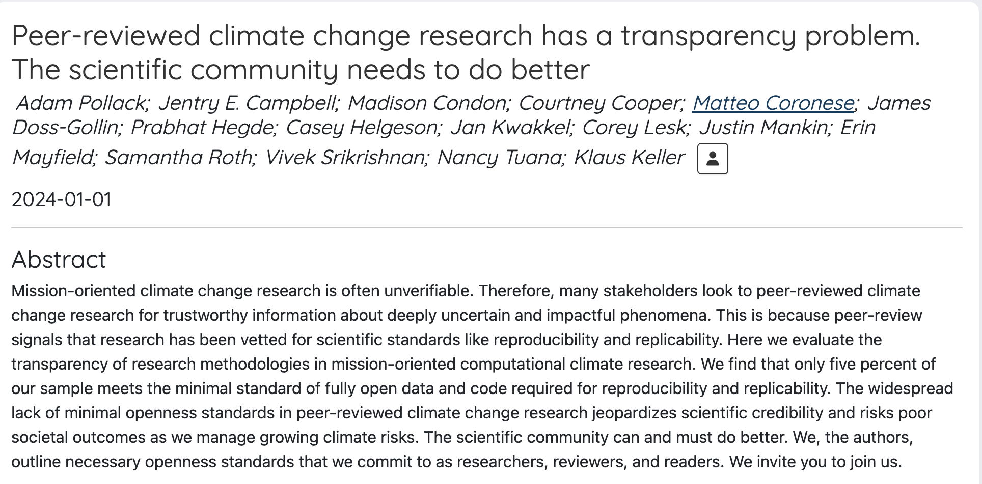
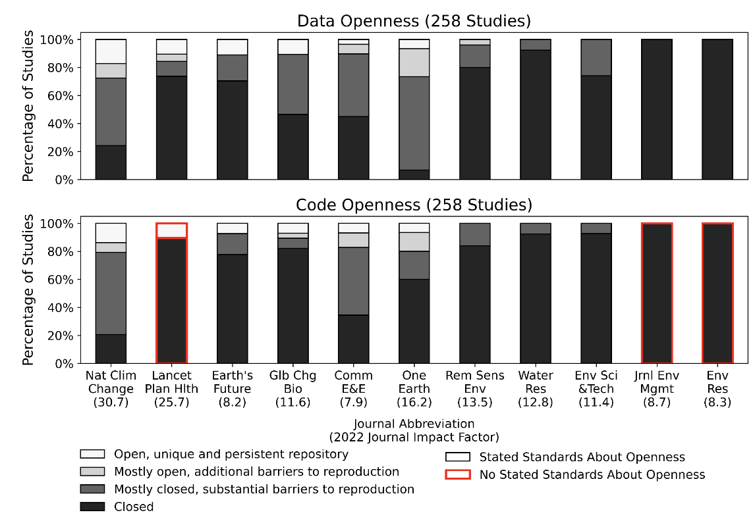
Example: Unearthing
underlying climate data and code
https://hdl.handle.net/11382/563753
https://doi.org/10.31219/osf.io/29nhv

Slide 15
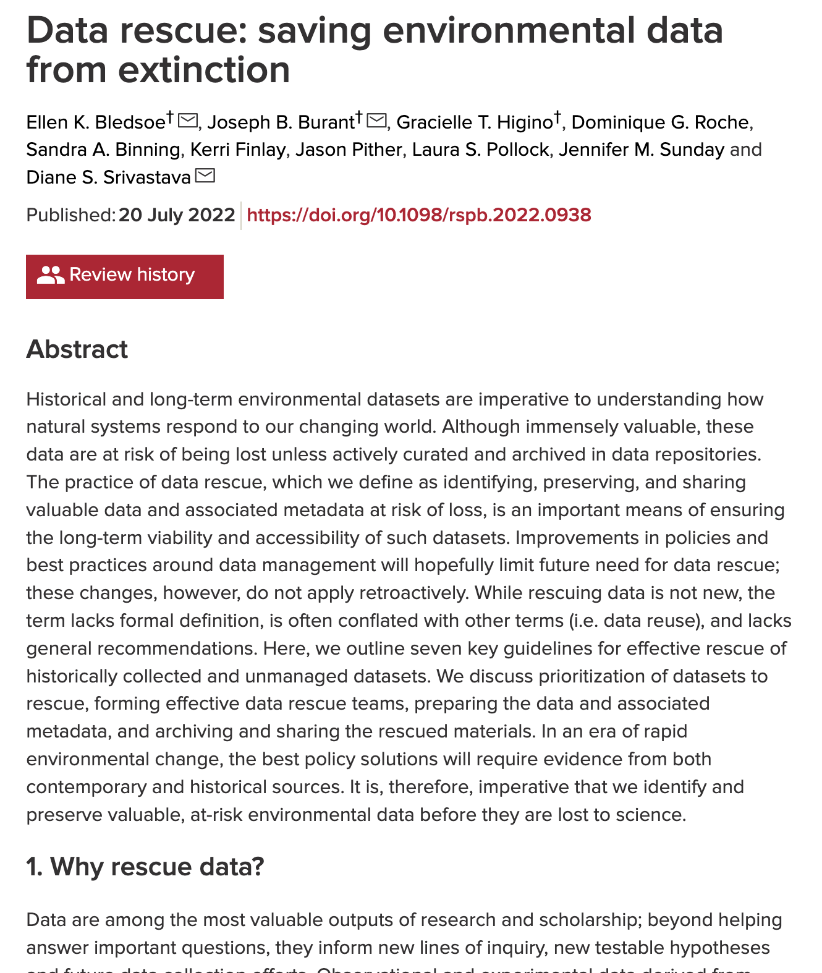
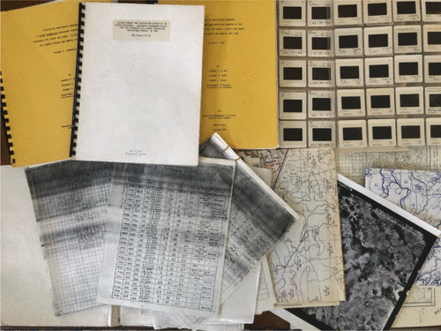
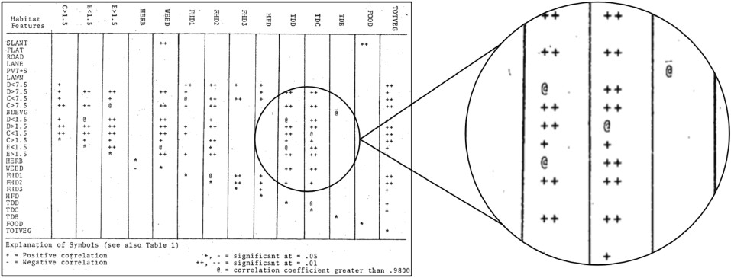
Example: Unboxing
and repacking it
non-standard data records from habitat features in forest ecology research
https://doi.org/10.1098/rspb.2022.0938

Slide 16
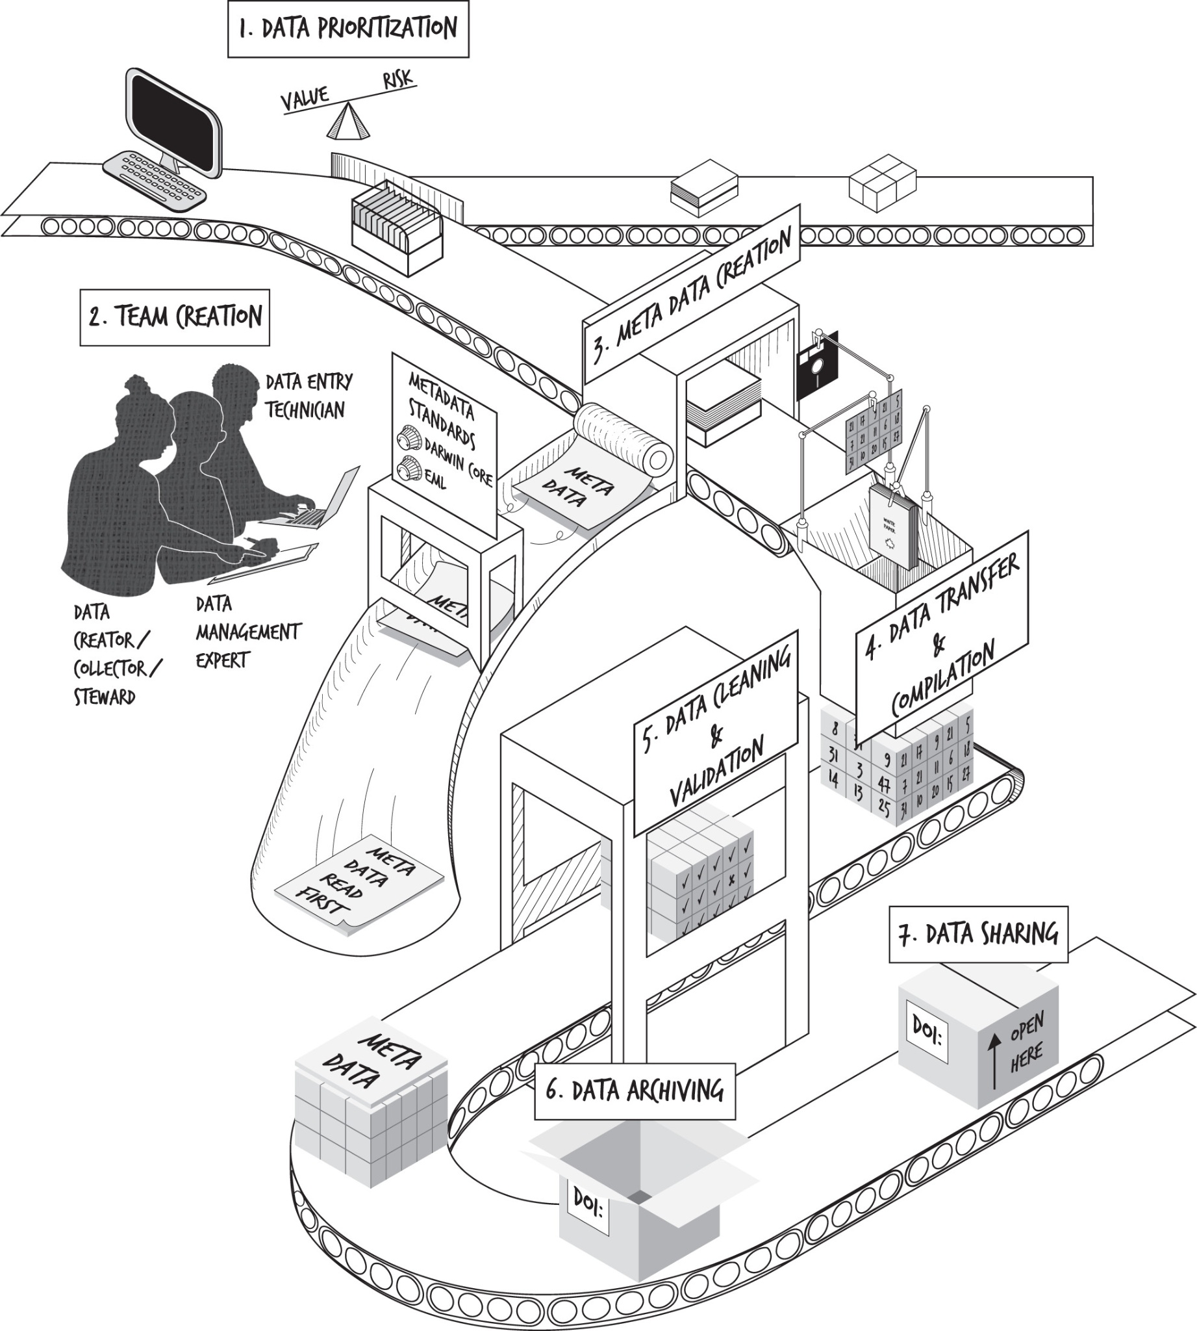
Data rescue assembly line https://doi.org/10.1098/rspb.2022.0938

Slide 17
Recommended Approaches
Document as you progress
Have others reviewing it
Cross-reference all project deliverables
Include proper attribution and provenance info
Choose a stable repository to archive data and code

Slide 18
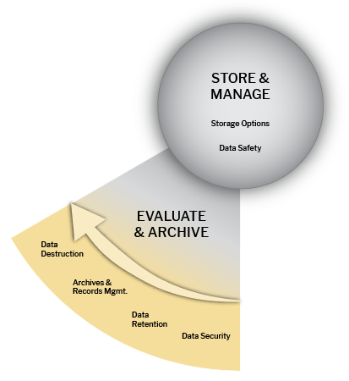
Potential Ethical Issues
COLLECT & CREATE
ANALYZE & COLLABORATE
EVALUATE & ARCHIVE
SHARE AND DISSEMINATE/PUBLISH & REUSE
Infringing rights and licensing
If you are using data that have been collected from another source, it’s important that you know from the beginning if there are any restrictions on how you can use and share the data. When generating new or derivative data you also have to make an informed decision about licenses, roles and responsibilities and rights governing the data.
Ethically & Responsibly

Slide 19
Ownership & Licensing Restrictions
“Through data ownership, data subjects call for the satisfaction of material needs and entitlements, and thus articulate and negotiate claims on the redistribution of resources. And for social beings for whom a fulfilled life depends on intersubjective prerequisites, data ownership further encodes expectations and demands on the recognition of proclaimed data owners. Both of these spheres need to be considered to grasp claims related to data ownership, and negotiating them is necessary to facilitate informational self-determination of data subjects.”
Carroll M. W. (2015). Sharing Research Data and Intellectual Property Law: A Primer. PLoS biology, 13(8), e1002235. https://doi.org/10.1371/journal.pbio.1002235

Slide 20
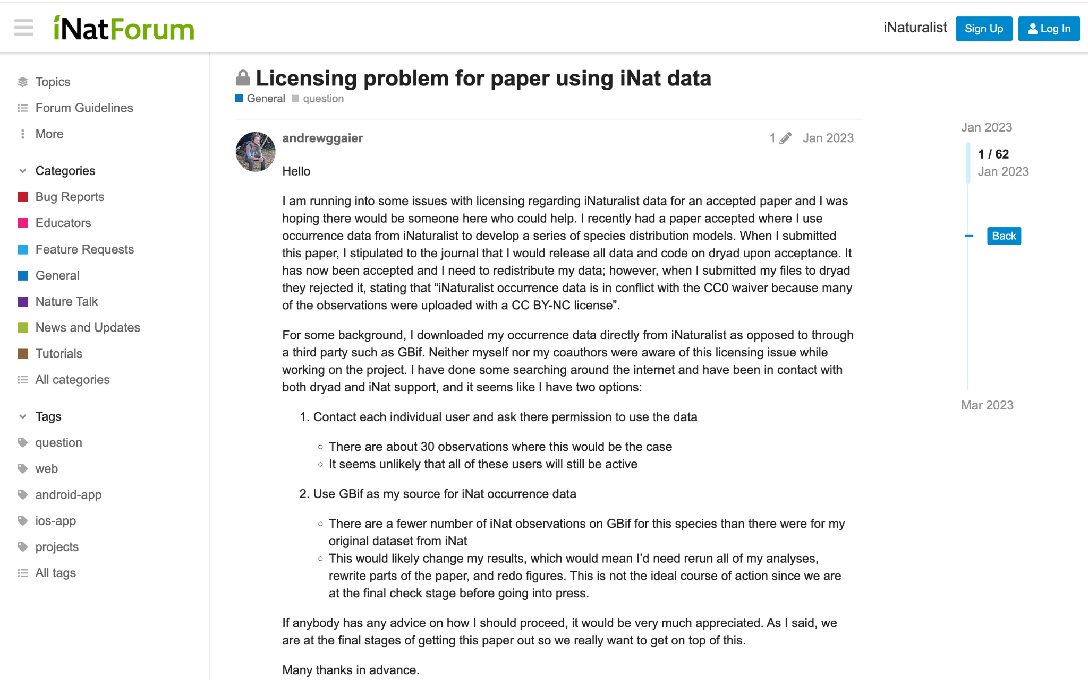
Example: When assumptions can go wrong
https://forum.inaturalist.org/t/licensing-problem-for-paper-using-inat-data/38480/7?page=2

Slide 21
Recommendations
Always check for licenses and terms and conditions governing the data
Access does not automatically grant you permission to reuse or redistribute data
Paying for the data does not necessarily grant you permission to reuse the data, share or redistribute the data
Verify existing policies for your organization, data providers, and any partner institutions (international requirements need special attention)

Slide 22
Potential DM Ethical Issues
PLAN & DESIGN
COLLECT & CREATE
ANALYZE & COLLABORATE
EVALUATE & ARCHIVE
SHARE AND DISSEMINATE
PUBLISH & REUSE
Mishandling Sensitive Data
Responsible handling of sensitive data is crucial in protecting privacy and confidentiality and preventing unauthorized access to data. Mishandling sensitive data can result in serious consequences, such as financial loss, lack of trust, retraction, and legal liabilities. Individuals and organizations must maintain trust by safeguarding sensitive data and complying with policies and regulations. By implementing strong security measures, such as encryption and access controls, de-identification and anonymization techniques and regularly reviewing and updating policies, we can ensure that sensitive data is treated ethically and responsibly.
Ethically & Responsibly

Slide 23
Sensitive Data
Any human subject data that can potentially disclose people’s identity and damage individual or collective reputations, rights, or best interests.
It also includes data, which, if disclosed without precaution, may infringe upon ethical agreements and threaten the ownership, representation, and existence of vulnerable communities, protected lands and species.

Slide 24
Sensitive Data Management
Successful long-term management and sharing of sensitive environmental data requires:
Consistency
Trust (all parties involved)
Risk management
Clear policies and shared practices
Effort to share the best available data

Slide 25
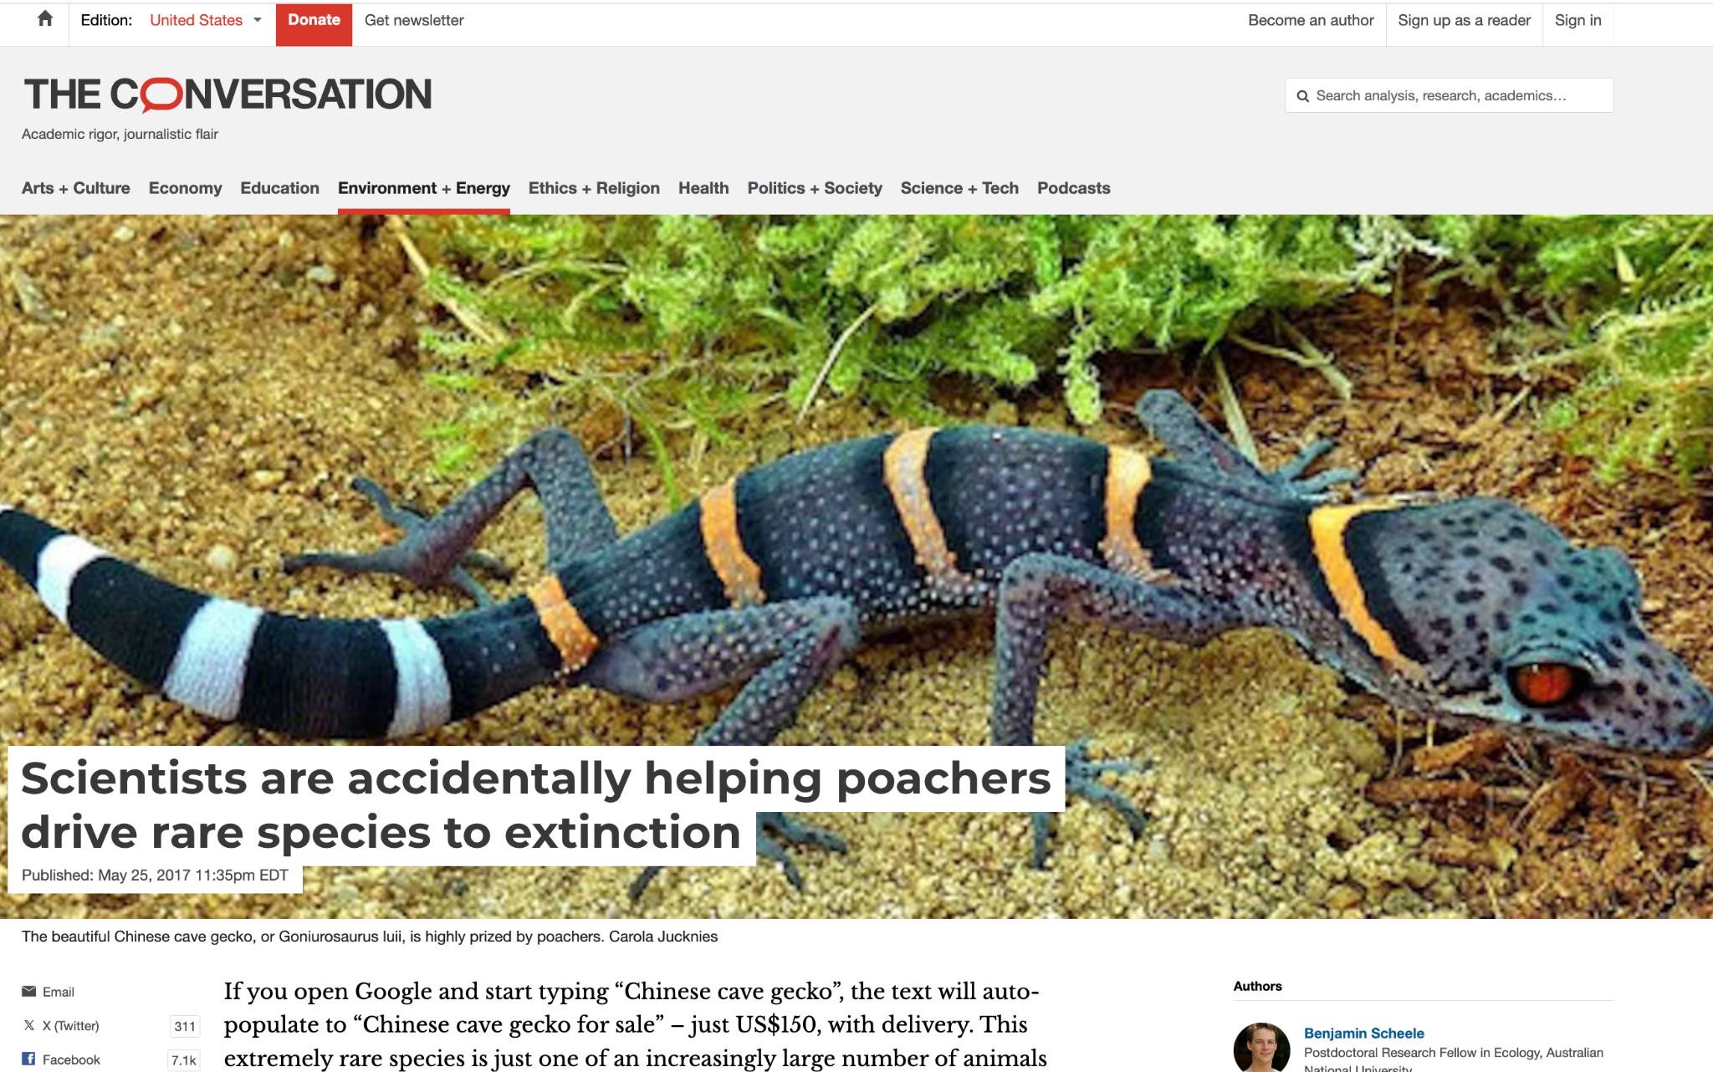
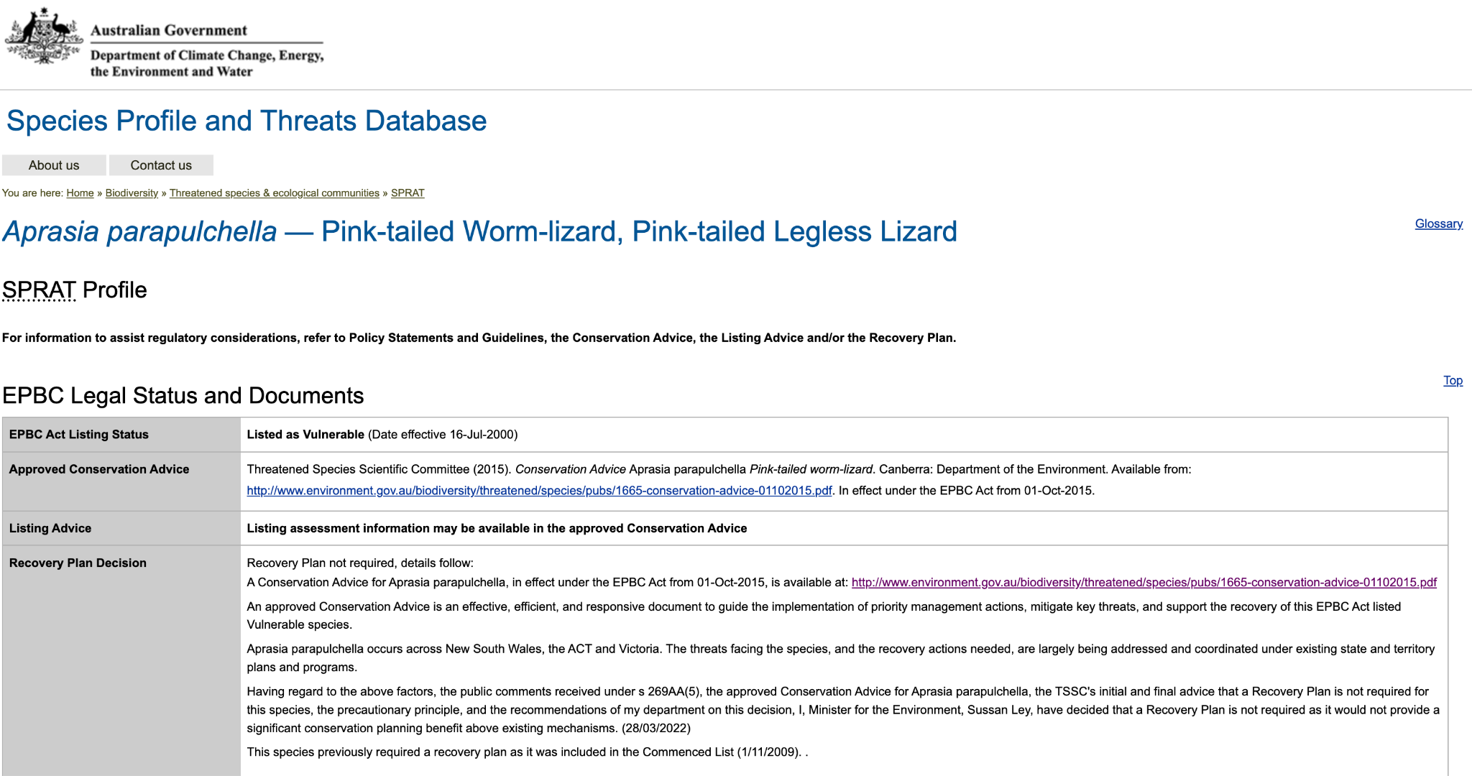
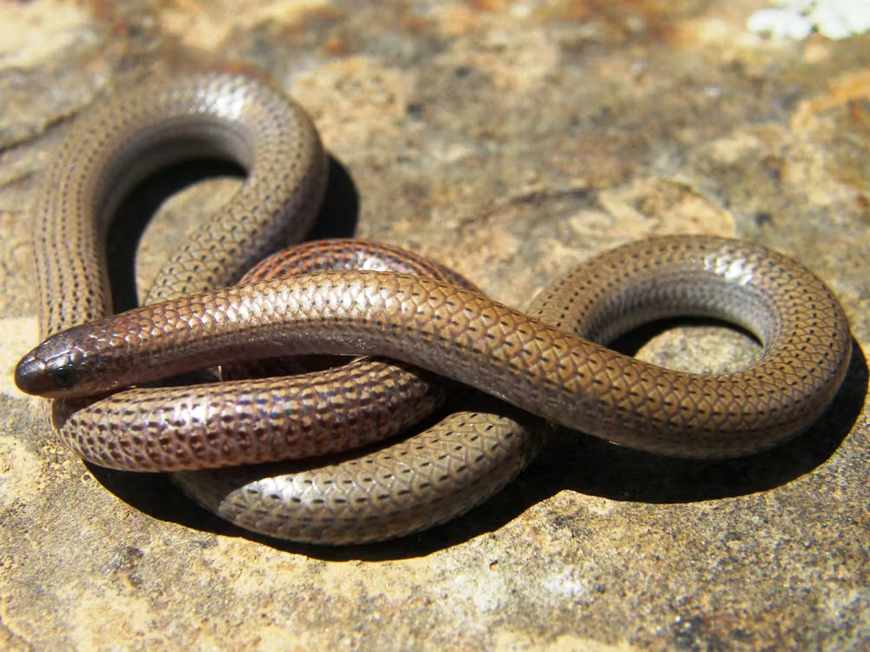
Researchers in New South Wales were required to provide location data on all species they discover during scientific surveys to an online wildlife atlas.
Rethink unrestricted access
After publishing the data, the landowners with whom researchers worked began to find trespassers on their properties.

Slide 26
Recommended Approaches
Only collect/keep sensitive data if strictly necessary
Classify datasets according to their level of sensitivity
Define security parameters for data access and control if needed
Implement data de-identification and anonymization techniques while assessing information loss and risk for re-identification
Set guidelines for data retention and archival period
Establish Data Use Agreements (DUA) to specify restrictions

Slide 27
Closing Thoughts
Responsible data management involves incorporating ethical and legal considerations across the whole data lifecycle
Any assumed or verified sources of distortion must be explicitly acknowledged and followed by strategies to mitigate them
When reusing someone else's data, we should observe existing licenses and terms and conditions
As data managers, we must protect vulnerable populations, marginalized communities, endangered species and protected sites
We must consider early in the life cycles stages strategies to improve data quality, produce detailed documentation, control for bias, and allow for transparency

